Slide 1
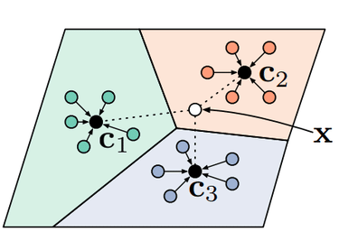
Learn to learn with few shots
Adi Hoftman, Yehonatan Escojido, Samuel Harroch, Dvir Shaul Supervised by: Dr. Roi Weiss

Slide 2
Introduction
Project goal : study a recently proposed deep learning method - a prototype network that uses a few-shot learning method.
Learning to learn: learn how to learn new tasks faster by reusing previous experience
Few-shot learning: given only a highly limited number of solved instances from the new task.

Slide 3
K-Nearest Neighbors
K-nearest neighbors (KNN) is a type of supervised learning algorithm. KNN tries to predict the correct class for the test data by calculating the distance between the test data and all the training points. Then select the K number of points which is closet to the test data.
Data set: notMNIST (A-J).
Train: N-support from sample images.
Test: N-Query from sample images.
Results: ~80% success in average (will discusses later).

Slide 4
Description of the process
Select sample select some images from the data randomly and divide to support set and query set.
Embed the images into vector of size 1X64.
Compute prototype- in this step we compute a prototype for each cluster.
Compute distance- we compute the distance between each unlabeled image and the prototypes.
Lunch train, in this area we just do those 4 step before.
For testing the Protonet, we give it a small labeled dataset, for each such single test we also ask K-NN to predict the class

Slide 5
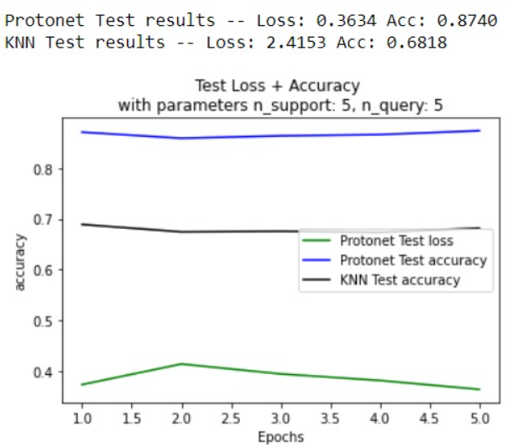
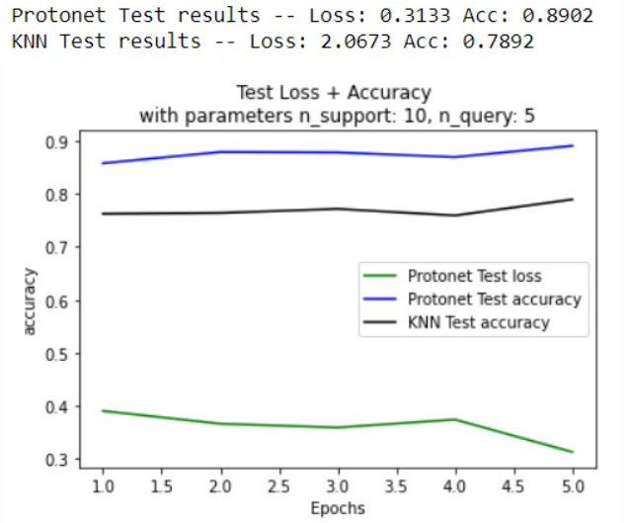

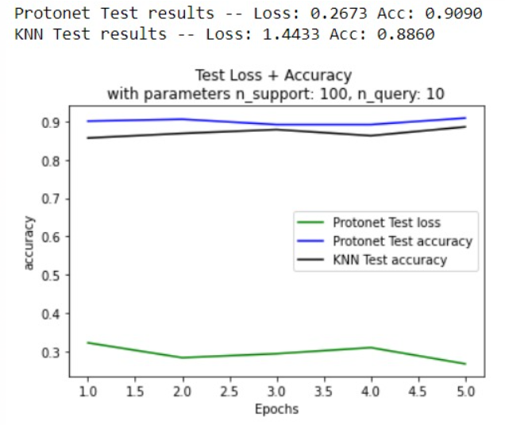
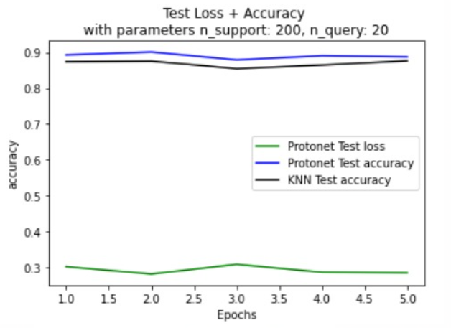
Comparisons
Epoch-size =2000
Total of iteration in train=10000
Number of classes = 5
Epoch-size =2000
Total of iteration in train=10000
Number of classes = 5

Slide 6
Conclusions
To sum up, we got the better result with the prototype network.
We can conclude that the KNN needs more data points to be more accurate.
Even though We saw an improvement in the results of KNN as more learning was performed with larger data.
In conclusion, it can be seen that the model we built provides relatively good and stable results when used in few shots learning

